Slide 1
Model Calculations
Munish Arora
Model Calculations
Using Data Analysis Expressions (DAX) to create calculated columns, measures, and custom tables.

Slide 2
Model Calculations
What is Data Analysis Expressions (DAX)
Calculated Columns
Measures
Calculate Function
Time-Intelligence Functions
Use relationships different from active relationship
Semi-Additive Measures
Quick Measures

Slide 3

Lesson 1: Introduction to Data Analysis Expressions (DAX)

Slide 4
What is Data Analysis Expressions (DAX)
Data Analysis Expressions (DAX) is
A library of functions and operators
Developed by Microsoft.
Used to build formulas and expressions.
Create calculated tables, columns, and measures.
Sales Amount = Average(Orders[Sales])
Sum is DAX function which is computing average value of Sales in Orders table

Slide 5
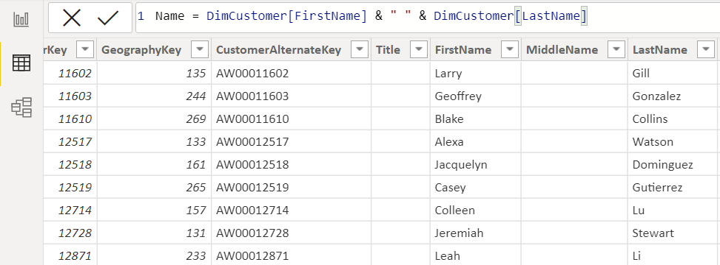
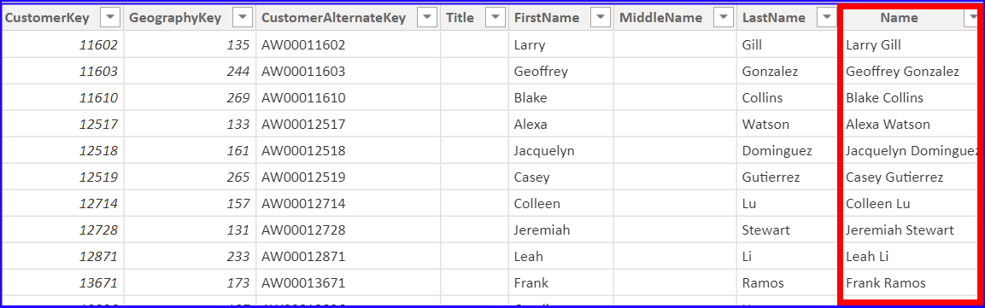
Calculated Column
A calculated column is an extension of a table using a DAX formula that is evaluated for each row.

Slide 6
Measures
Measures are
A summarization of data, often called “Calculated Measures”.
Computed at runtime
Stored temporarily
Limited By Filter Context (As applied)
Order ID | Order Date | Customer ID | Sales Amount | Payment Status
1001 | 1-Jan-18 | 4 | 340 | Complete
1002 | 2-Jan-18 | 4 | 307 | Pending
1003 | 3-Jan-18 | 2 | 101 | Complete
1004 | 4-Jan-18 | 3 | 335 | Pending
1005 | 5-Jan-18 | 4 | 206 | Complete
1006 | 6-Jan-18 | 3 | 145 | Complete
1007 | 7-Jan-18 | 2 | 166 | Pending
Payment Status | Sales Amount
Complete | 792
Pending | 808
Grand Total | 1600
Summarize

Slide 7
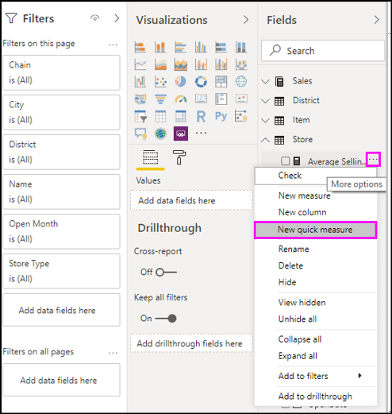
Quick Measures
Quick measures help us quickly create new measures based on measures and numerical columns in your table.
These new measures become part of your model and can be used in any of your charts, just like manually created DAX calculations.

Slide 8
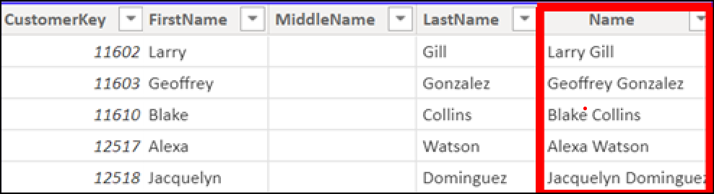
Columns vs. Measures
Calculated column
Creates a value for each row in a table
Measures
Calculated on demand
Calculated based on filters
Saved temporarily
Order ID | Sales Amount | Payment Status
1001 | 340 | Complete
1002 | 307 | Pending
1003 | 101 | Complete
1004 | 335 | Pending
1005 | 206 | Complete
1006 | 145 | Complete
1007 | 166 | Pending
Payment Status | Sales Amount
Complete | 792
Pending | 808
Grand Total | 1600
Summarize

Slide 9
Knowledge Check
Q01 – Which are calculated on demand?
Calculated columns
Measures
A01 - A
Q02 –Which are based on filters?
Calculated columns
Measures
A02 - A

Slide 10
Lab 03: Create DAX Calculations in Power BI Desktop
In this lab you will commence developing the data model. It will involve creating relationships between tables, and then configuring table and column properties to improve the friendliness and usability of the data model. You will also create hierarchies and create quick measures.

Slide 11
Lesson 02: Context
The filter context is nothing but a filter currently active on the visual /data model

Slide 12
Understanding Context
Category ID | Category Name
CAT A | Category A
CAT B | Category B
Date | Month | Year
01 Jan 2021 | Jan | 2021
02 Jan 2021 | Jan | 2021
01 Jan 2022 | Jan | 2022
Product ID | Product Name | Category ID
PRO A | Product A | CAT A
PRO B | Product B | CAT B
PRO C | Product C | CAT A
Order ID | Product ID | Order Date | Sales Amount
1 | Pro A | 01 Jan 2021 | 1200
2 | Pro B | 01 Jan 2021 | 1500
3 | Pro C | 02 Jan 2022 | 1600

Slide 13
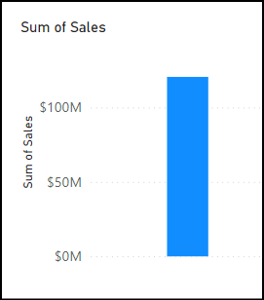
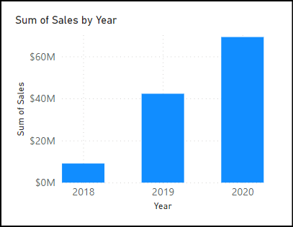
Understanding Context
Filter of Year

Slide 14
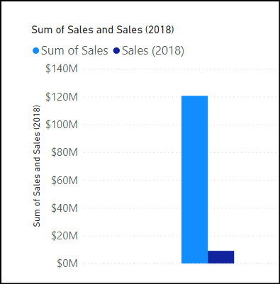
Calculate Function
Evaluates an expression which is then modified by filters.
You can add any number of filters to the function, and
can change the context in which the data is filtered.
Total Sales for 2018 =
CALCULATE(
SUM('Sales’[Sales Amount]),
YEAR('Sales'[orderdate]) = 2018 )
Expression
Filter Context

Slide 15
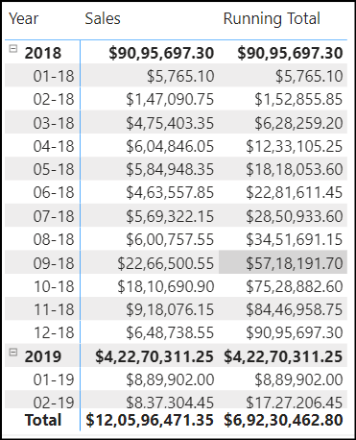
Time-Intelligence Functions
Time Intelligence functions
Allow us to manipulate data using time periods, including days, months, quarters, and years, and then
Build and compare calculations over those periods.
Running Total= TOTALYTD(
SUM('SalesOrder'[Sales]),
'Date'[Date]
)

Slide 16
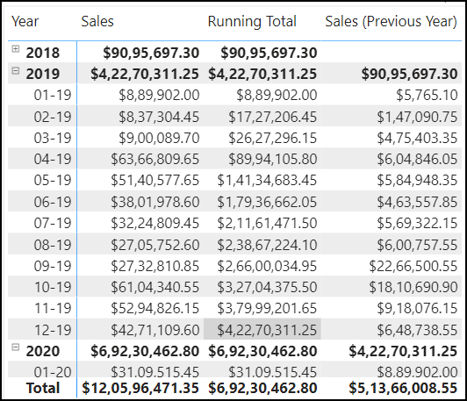
Time-Intelligence Functions
We can also use Calculate function and specify the filter criteria
Sales(Previous Year) = CALCULATE(
SUM('SalesOrder'[Sales]), PREVIOUSYear(Dates[Date]) )

Slide 17
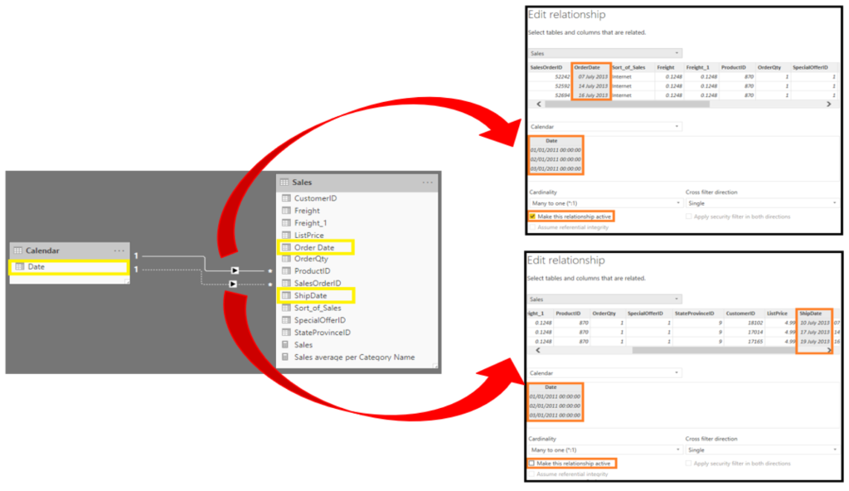
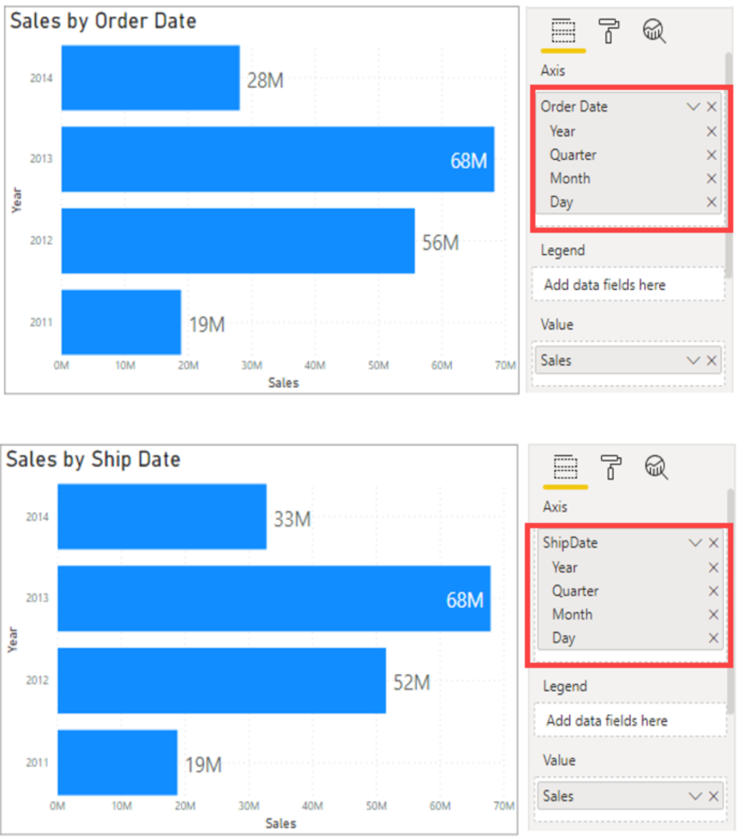
Use relationships different from active relationship
Active relationships propagate filters to other tables.
Sales by Ship Date =
CALCULATE(Sales[TotalPrice],
USERELATIONSHIP('Calendar'[Date], Sales[ShipDate]))

Slide 18
Semi-Additive Measures
Semi additive measures are measures that have to be aggregated differently over different dimensions.
Commonly used over Time dimensions.
For example fetch inventory count on last day of month
Last Inventory Count =
CALCULATE
(
SUM ( 'Warehouse'[Inventory Count] ),
LASTDATE ( 'Date'[Date] )
)

Slide 19
Non-Additive Measures
Non additive measures are measures that can not be aggregated.
For example, if you are dealing with the discount percentage, you can not aggregate the discount %age.

Slide 20
Knowledge Check
Q01 – What type of Measure uses SUM to aggregate over one set of dimensions and a different aggregation over a different set of dimension?
Semi-Additive
Non-Additive
Quick
A01 - A
Q02 –What type of functions enable you to manipulate data using time periods??
Time Intelligence
Information
Logical
A02 - A

Slide 21
Knowledge Check
Q01 – Which functions will help you compare dates to the previous month?
PREVIOUSMONTH
DateAdd
SamePeriodLastMonth
A01 – A, B

Slide 22
Lab 04: Create DAX Calculations in Power BI Desktop Advanced
In this lab you will create measures with DAX expressions involving filter context manipulation.
In this lab you learn how to:
Use the CALCULATE() function to manipulate filter context
Use Time Intelligence functions

Slide 23
Lab 05: Using Parameter Table To Display In Specified Units
In this lab you will learn to display Sales Amount in any of following units,as per user selection.
Real Value
Thousands
Millions
Billions

